Slide 1
Distributed System
Dr / nermin

Slide 2
Q1:How do networked computers communicate and coordinate their actions?
-A networked computers is a distributed system whose components are located on different networked computers, which then communicate and coordinate their actions by passing messages to one another. The components interact with one another in order to achieve a common goal.

Slide 3
Examples of goals to be achieved:-
1)resource sharing
– the possibility of using available resources any where
2)openness
– an open distributed system can be extended and improved
3)incrementally
– requires publication of component interfaces and standards protocols and for accessing interfaces
4)scalability
– the ability to serve more users.

Slide 4
Q2: The role of firewall is
Protect networks or network devices from unauthorized access by preventing network traffic to or from these systems.

Slide 5
Q3: what are trends of DS?
Pervasive networking & the modern internet
wireless communication technology
wifi, wimax, blue tooth
the internet includes them all
the internet is a huge distributed system
provide basic services like the web, mail, file transfer
the list of available services is open-ended
multiple organization boundaries
intranets, firewalls
technical & organizational boundaries

Slide 6
Continue Q3
Mobile & ubiquitous computing
small & portable computing devices
laptops, handheld devices, wearable devices, embedded devices
key features
portability, mobile connectivity
situatedness
location-awareness, context awareness, reactiveness
autonomy
working in disconnected mode, self-awareness

Slide 7
Continue Q3
Distributed multimedia systems
supporting multimedia services in distributed systems
continuous media
webcasting
Distributed computing as a utility
distributed resources as commodity
physical resources
virtual resources
cloud coputing

Slide 8
Q4:what is the difference between an application and service?
Service often target smaller and more isolated problems than application
Application often expose and call services, sometimes services in other applicatins

Slide 9
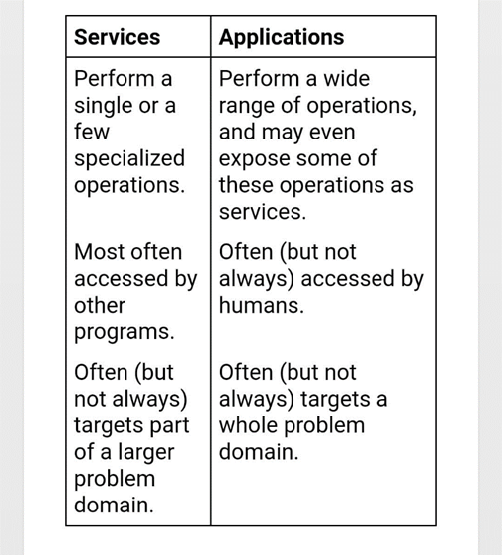
Continue services vs. applications

Slide 10
Q5: give two examples explained that the security is an important parameter in exchanging data on DS...
An operating system can only control its own machine’s resources. Thus, operating systems will have challenges in providing security in distributed systems, where more than one machine must cooperate. There are two large problems:
1-the other machines in the distributed system might not properly implement the security policies you want, or they might be adversaries impersonating trusted partners. We cannot control remote system,, but we still have to be able to trust validity of the credentials and capabilities they give us.

Slide 11
Continue Q5
2- machines in a distributed system communicate across a network that none of them fully control and that, generally, cannot be trusted. Adversaries often have equal access to that network and can forge, copy, replay, alter, destroy, and delay our message, and generally interfere with our attempts to use the network.

